Slide 1
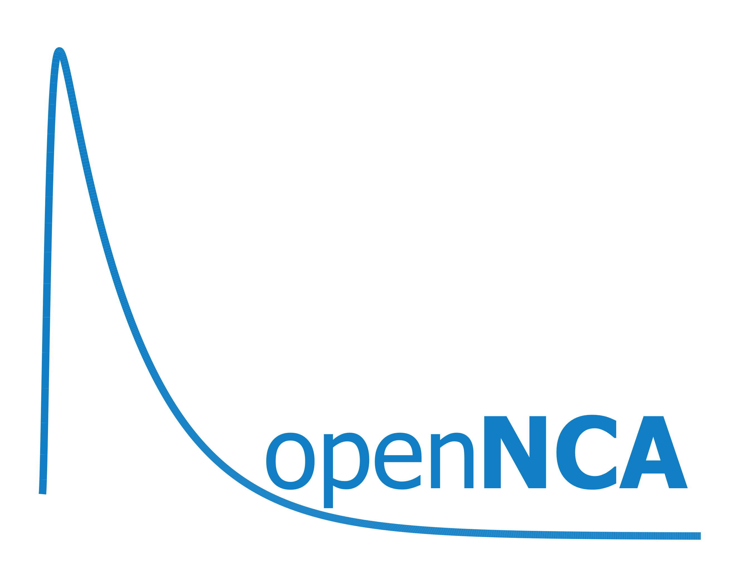

Pharmacokinetic data repository and Non-compartmental Analysis System
R/Pharma 2020
Tom Tensfeldt
Pfizer Research and Development
Thomas.g.Tensfeldt@Pfizer.com

Slide 2
what is NCA?
Non-compartmental Analysis (NCA) is essential to pharmacokinetic (PK) analysis of clinical and pre-clinical drug exposure data
Standard method of assessment for Phase 1 clinical studies
Provides PK characteristics of drug exposure contributing to dose/regimen selection
Results of NCA analyses are used to inform critical decision-making processes during drug development and required to support drug registration and labeling recommendations.
Clinical Research and Development require robust, modern, adaptable, qualified analysis tools for PK.
Currently available commercial and non-commercial NCA software offer limited options and flexibility for complex analyses or integration into wider pharmacometric workflows.
Single/Multple Ascending Dose
Drug Drug Interaction
ADME
Bioequivalence
Special Populations
(Hepatic/Renal impairment)
Cmax
AUC
Tmax

Slide 3
what is openNCA?
Industrial, qualified application leveraging R for data management, analysis and reporting
R based NCA Computation Engine open-source package
Open-source application
Open-source replacement to eNCA
developed as an innovative open-source replacement to eNCA, an in-house developed bioanalytical data repository and non-compartmental PK analysis web-based system from 2007
openNCA version 2.0 placed into active production use June 1st 2020
Version 2.1 under active development (Oct delivery) with multiple future releases planned
Modular desktop application leveraging
web services for repository, logging, compute services, publishing, access controls, auditing, etc.
docker containers for R and Rstudio for data management, visualization, analysis, summary, reporting capabilities
NCA calculations performed through the companion R package, openNCA computation engine.

Slide 4
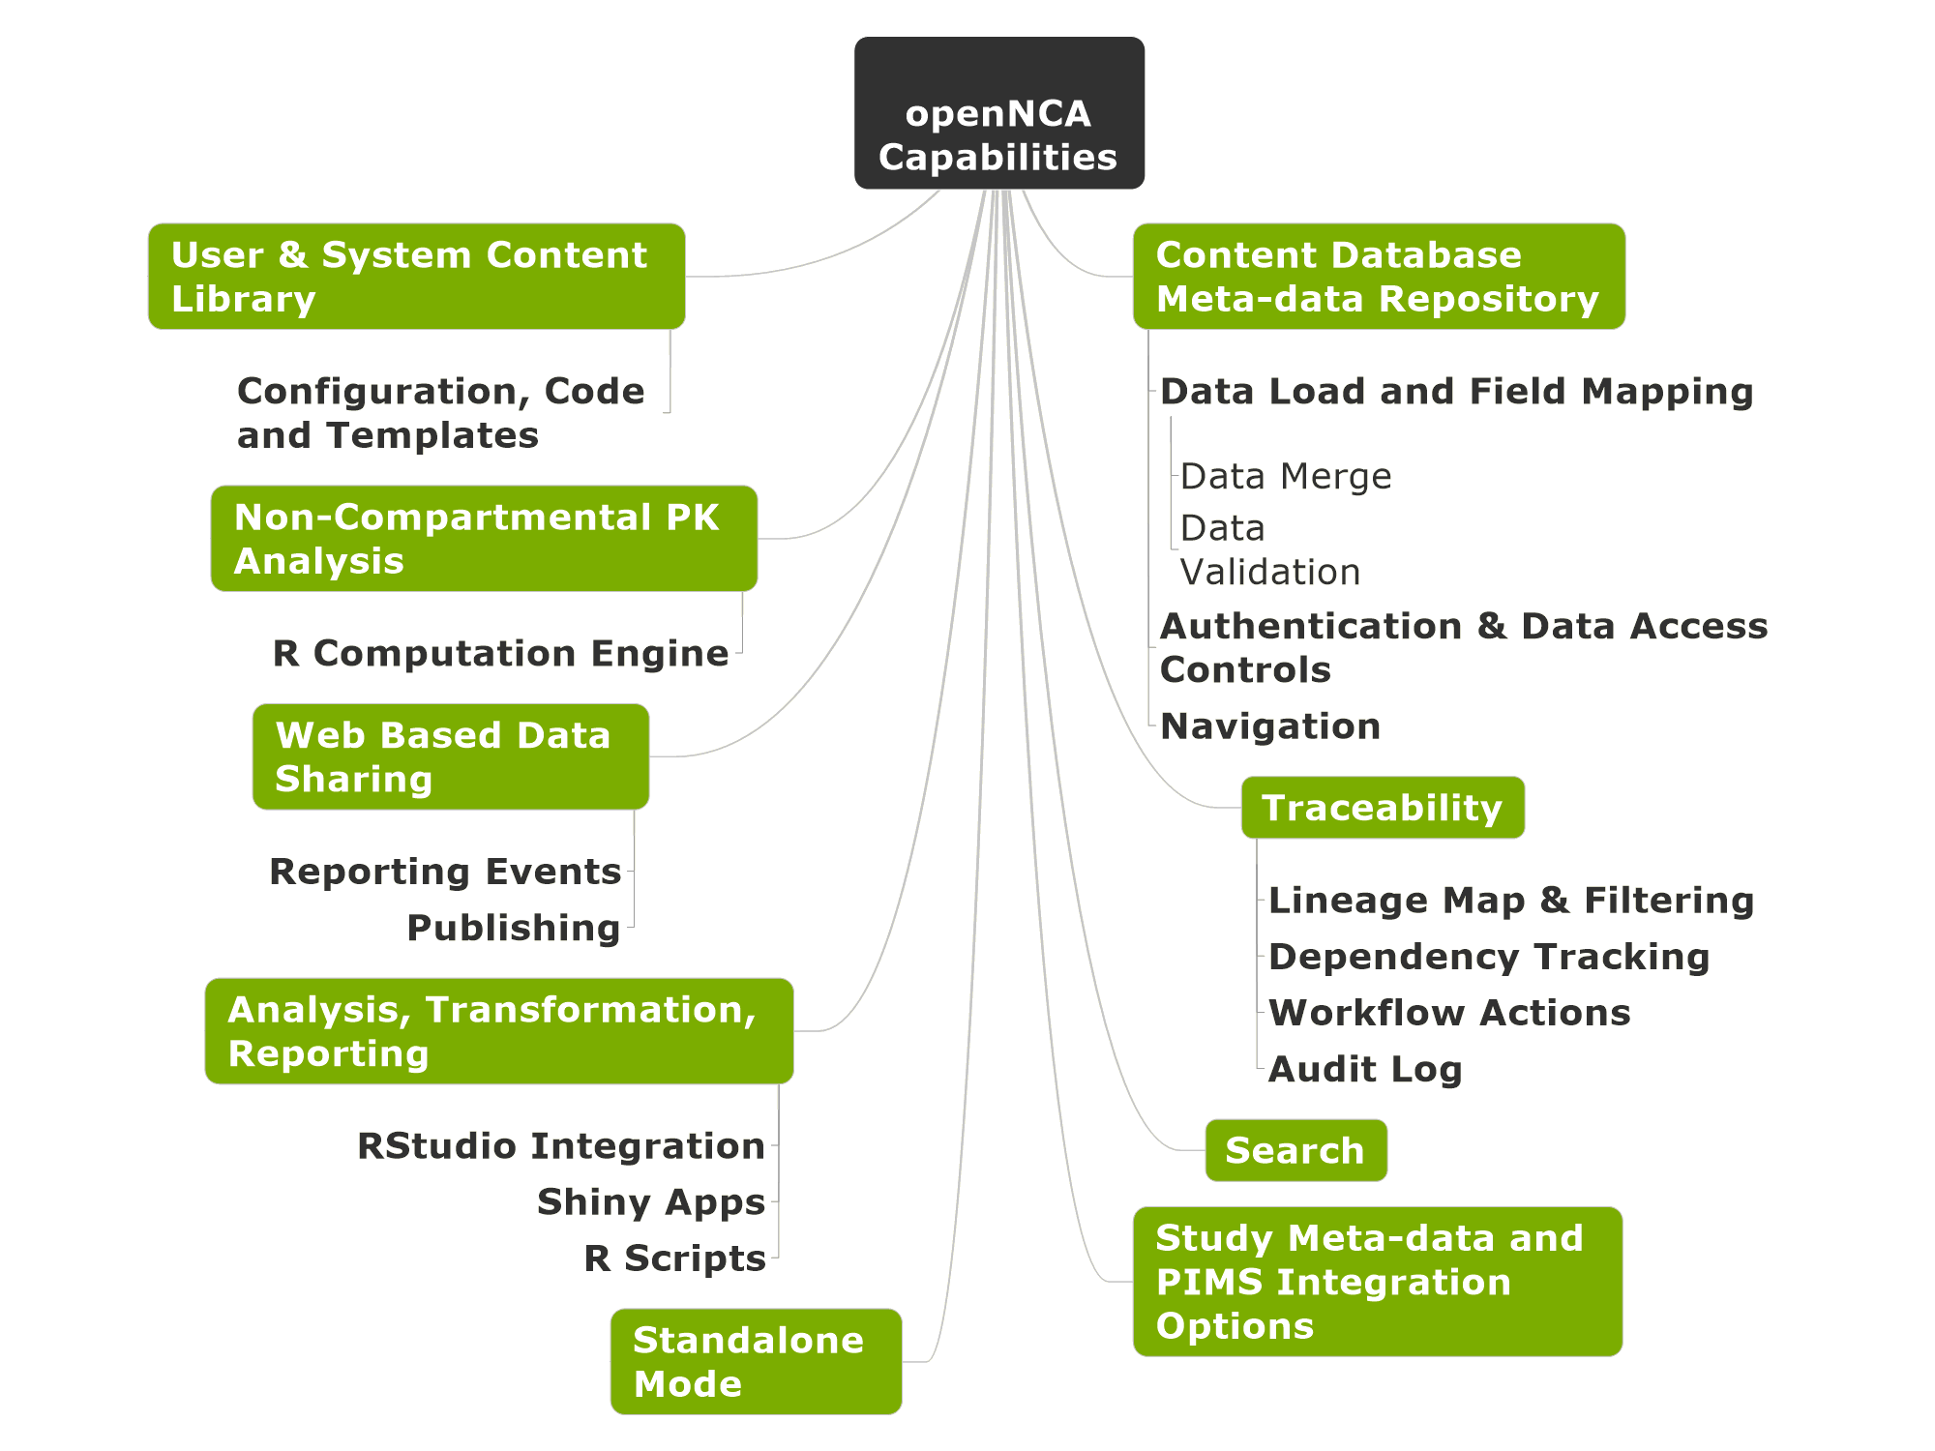

Slide 5






Non-compartmental PK Analysis
Data Transformation, Visualization & Reporting
User & System Content Library
Traceability
Content & meta-data Repository
Open Source

Slide 6
Traceability Features

Slide 7
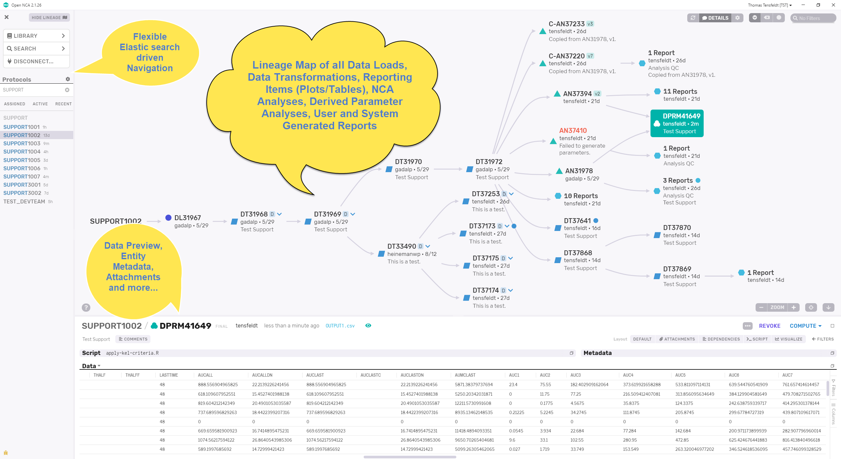
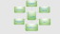
Lineage Map & Filtering
Dependency Tracking
Content Management
Version Control
Map Filtering/ Focusing
Audit Logging

Slide 8
Content & Meta-data Repository

Slide 9
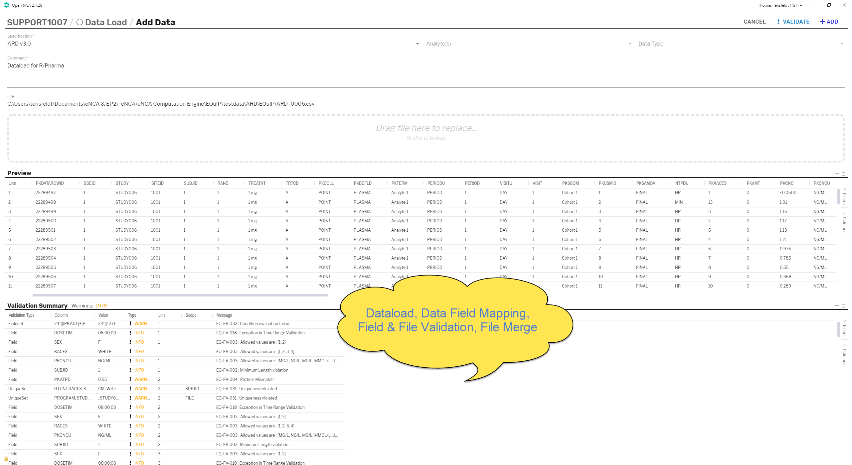
Data Loading
Dataload
CSV, Excel (xls/xlsx)
Load arbitrary numbers of datasets
Field Mapping
Data Merge
Content/ Structure Validation

Slide 10
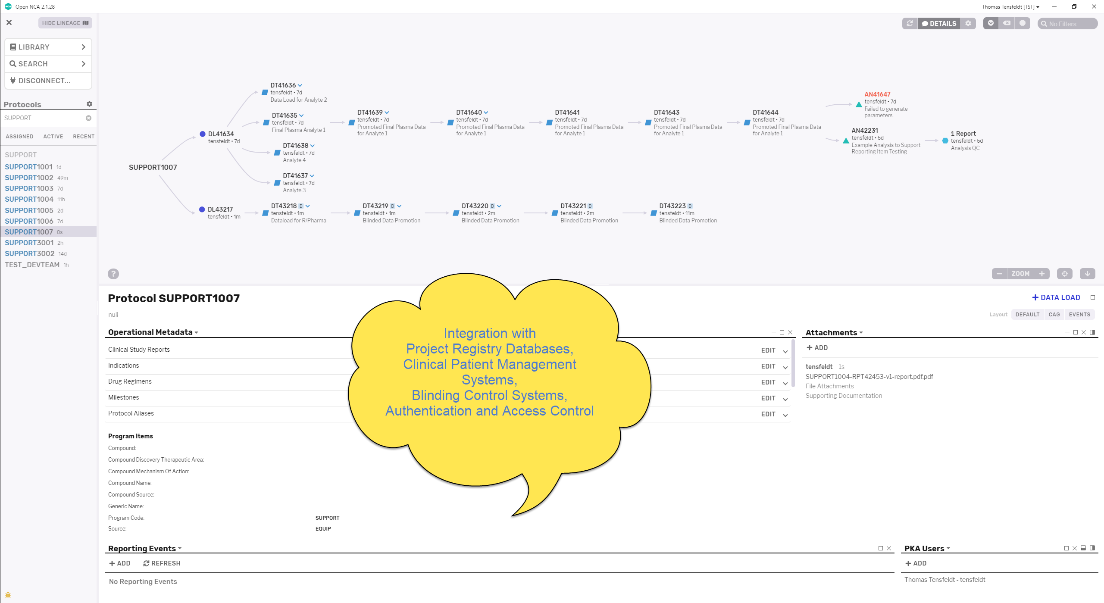
Protocol Registration Meta-data Authentication & Data Access Controls

Slide 11
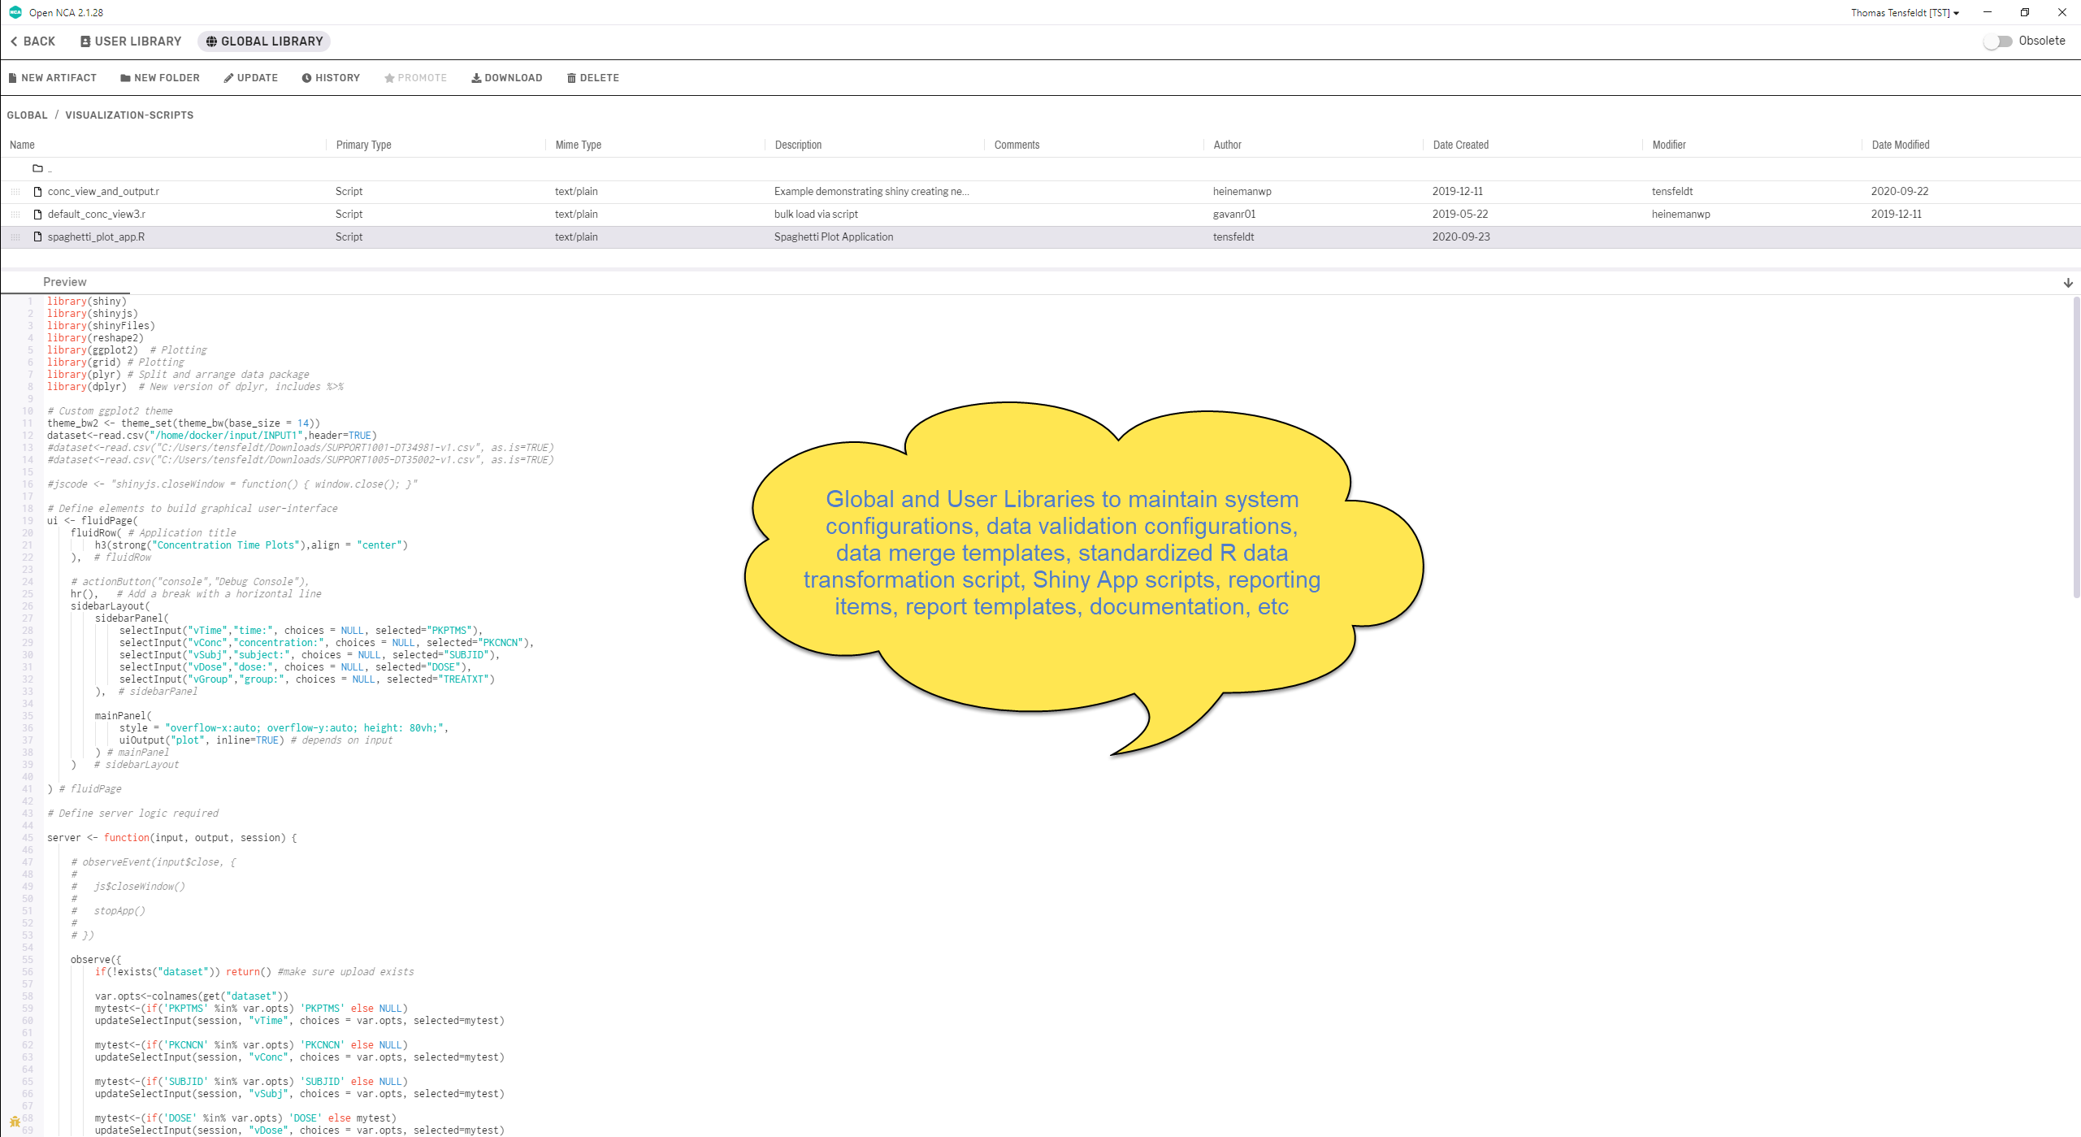

User and Global Library

Slide 12
Data Transformation, Visualization & Reporting

Slide 13
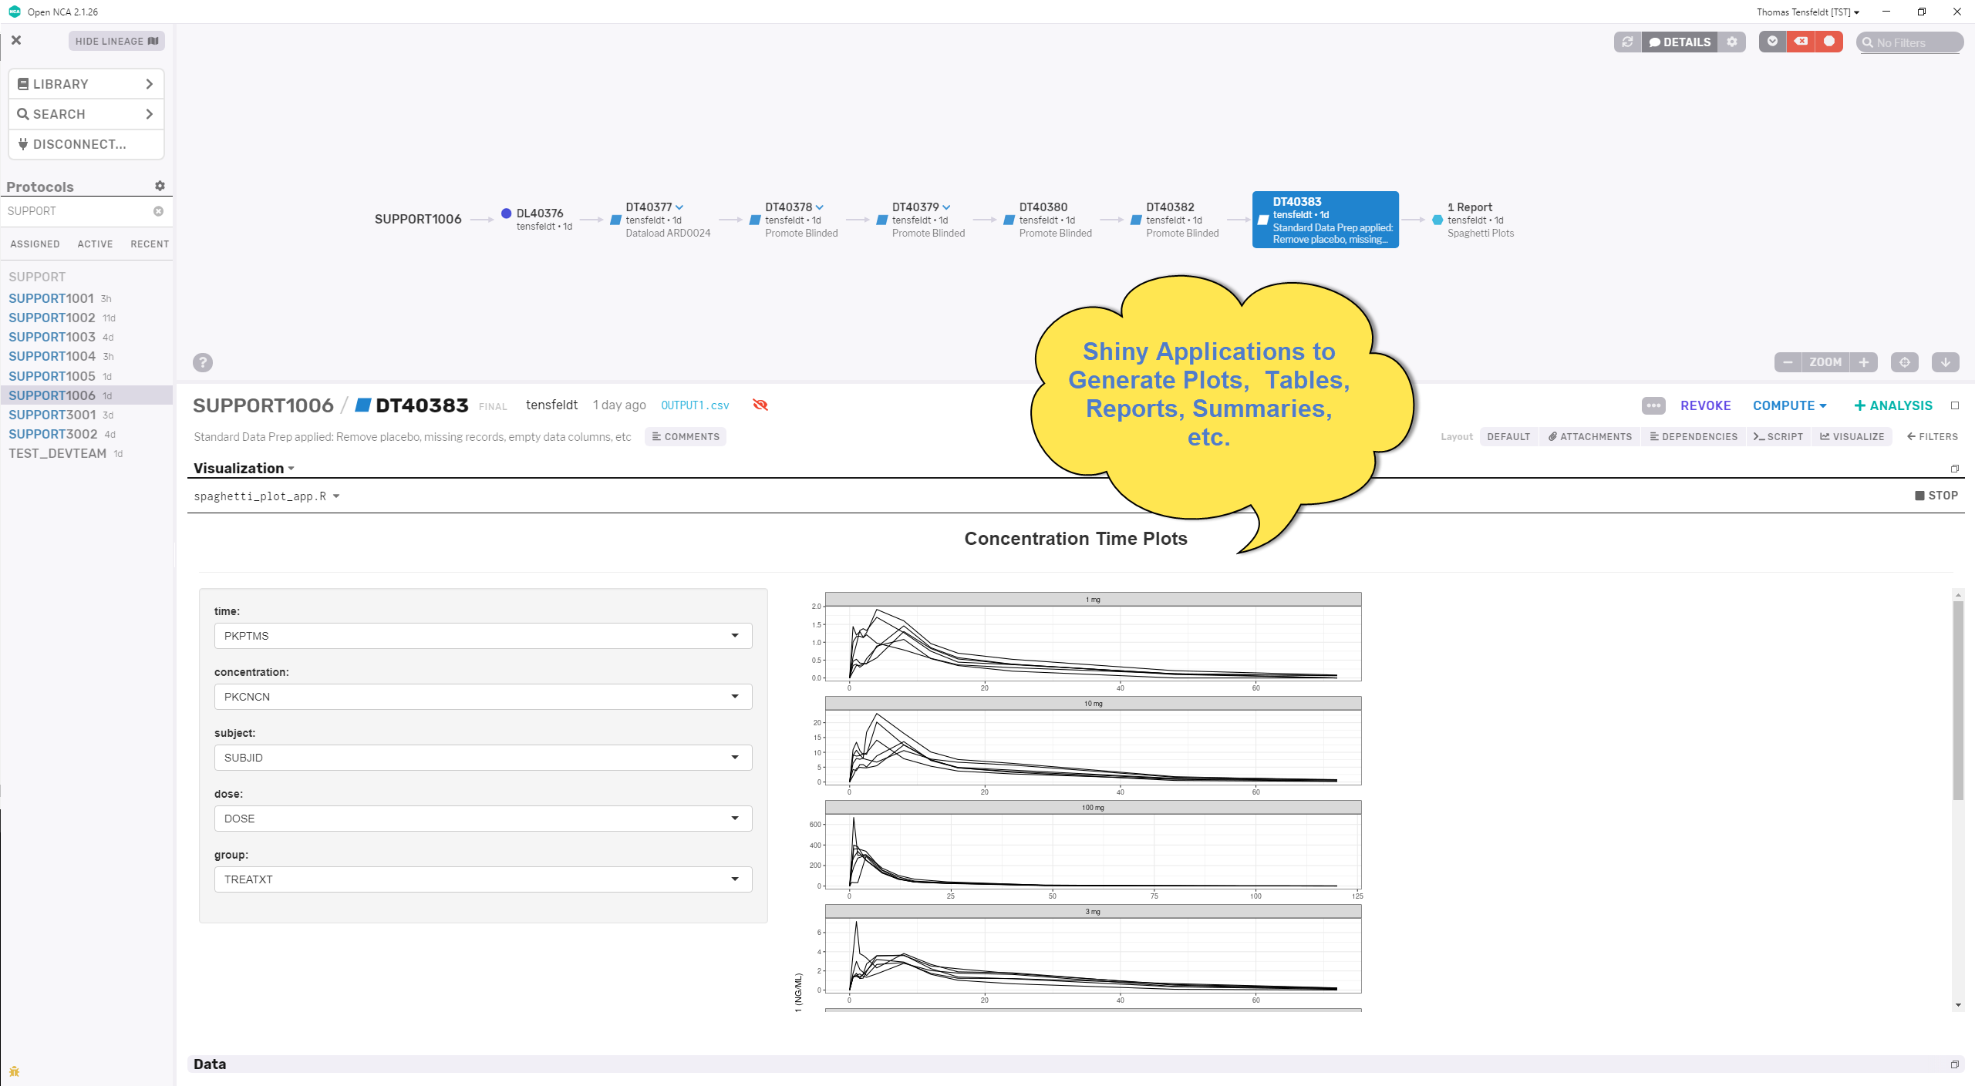
Visualization

Slide 14
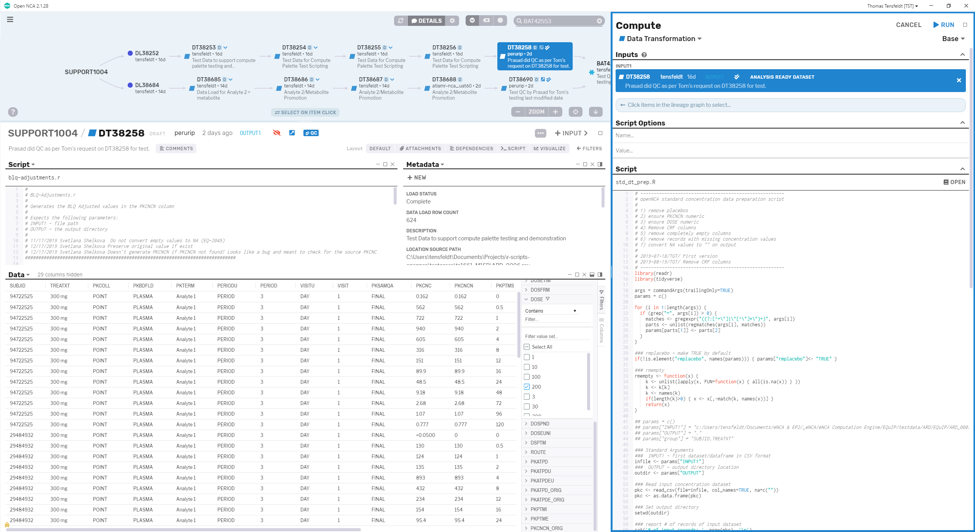
R Driven Data Transformations
Automated and Manual Data Preparation for Analyses
RStudio Sessions
Shiny apps
Units conversion

Slide 15
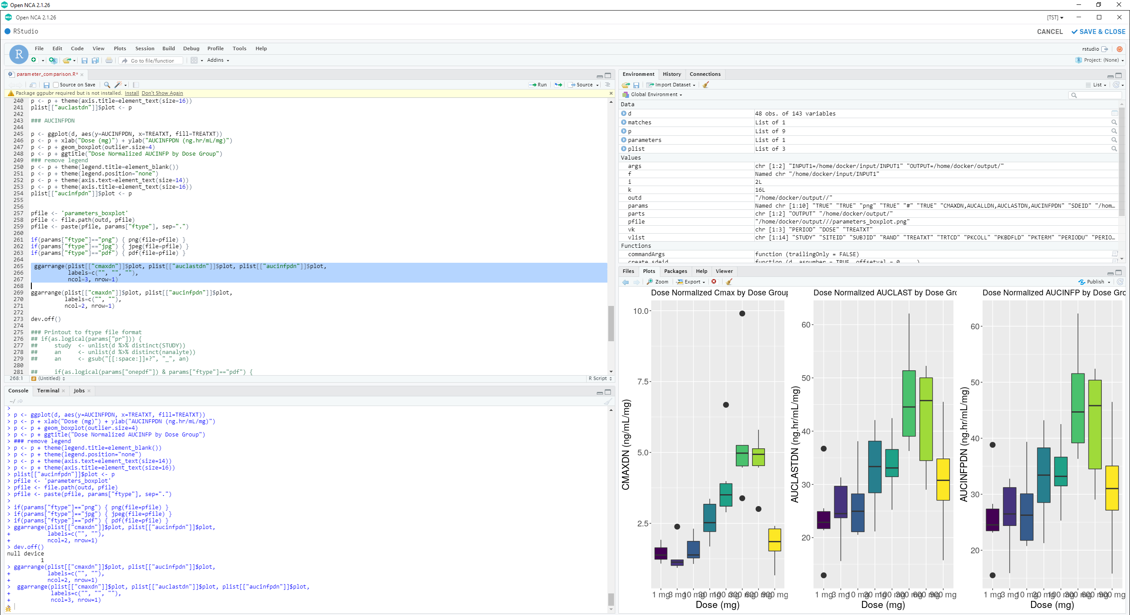
Rstudio IDE

Slide 16
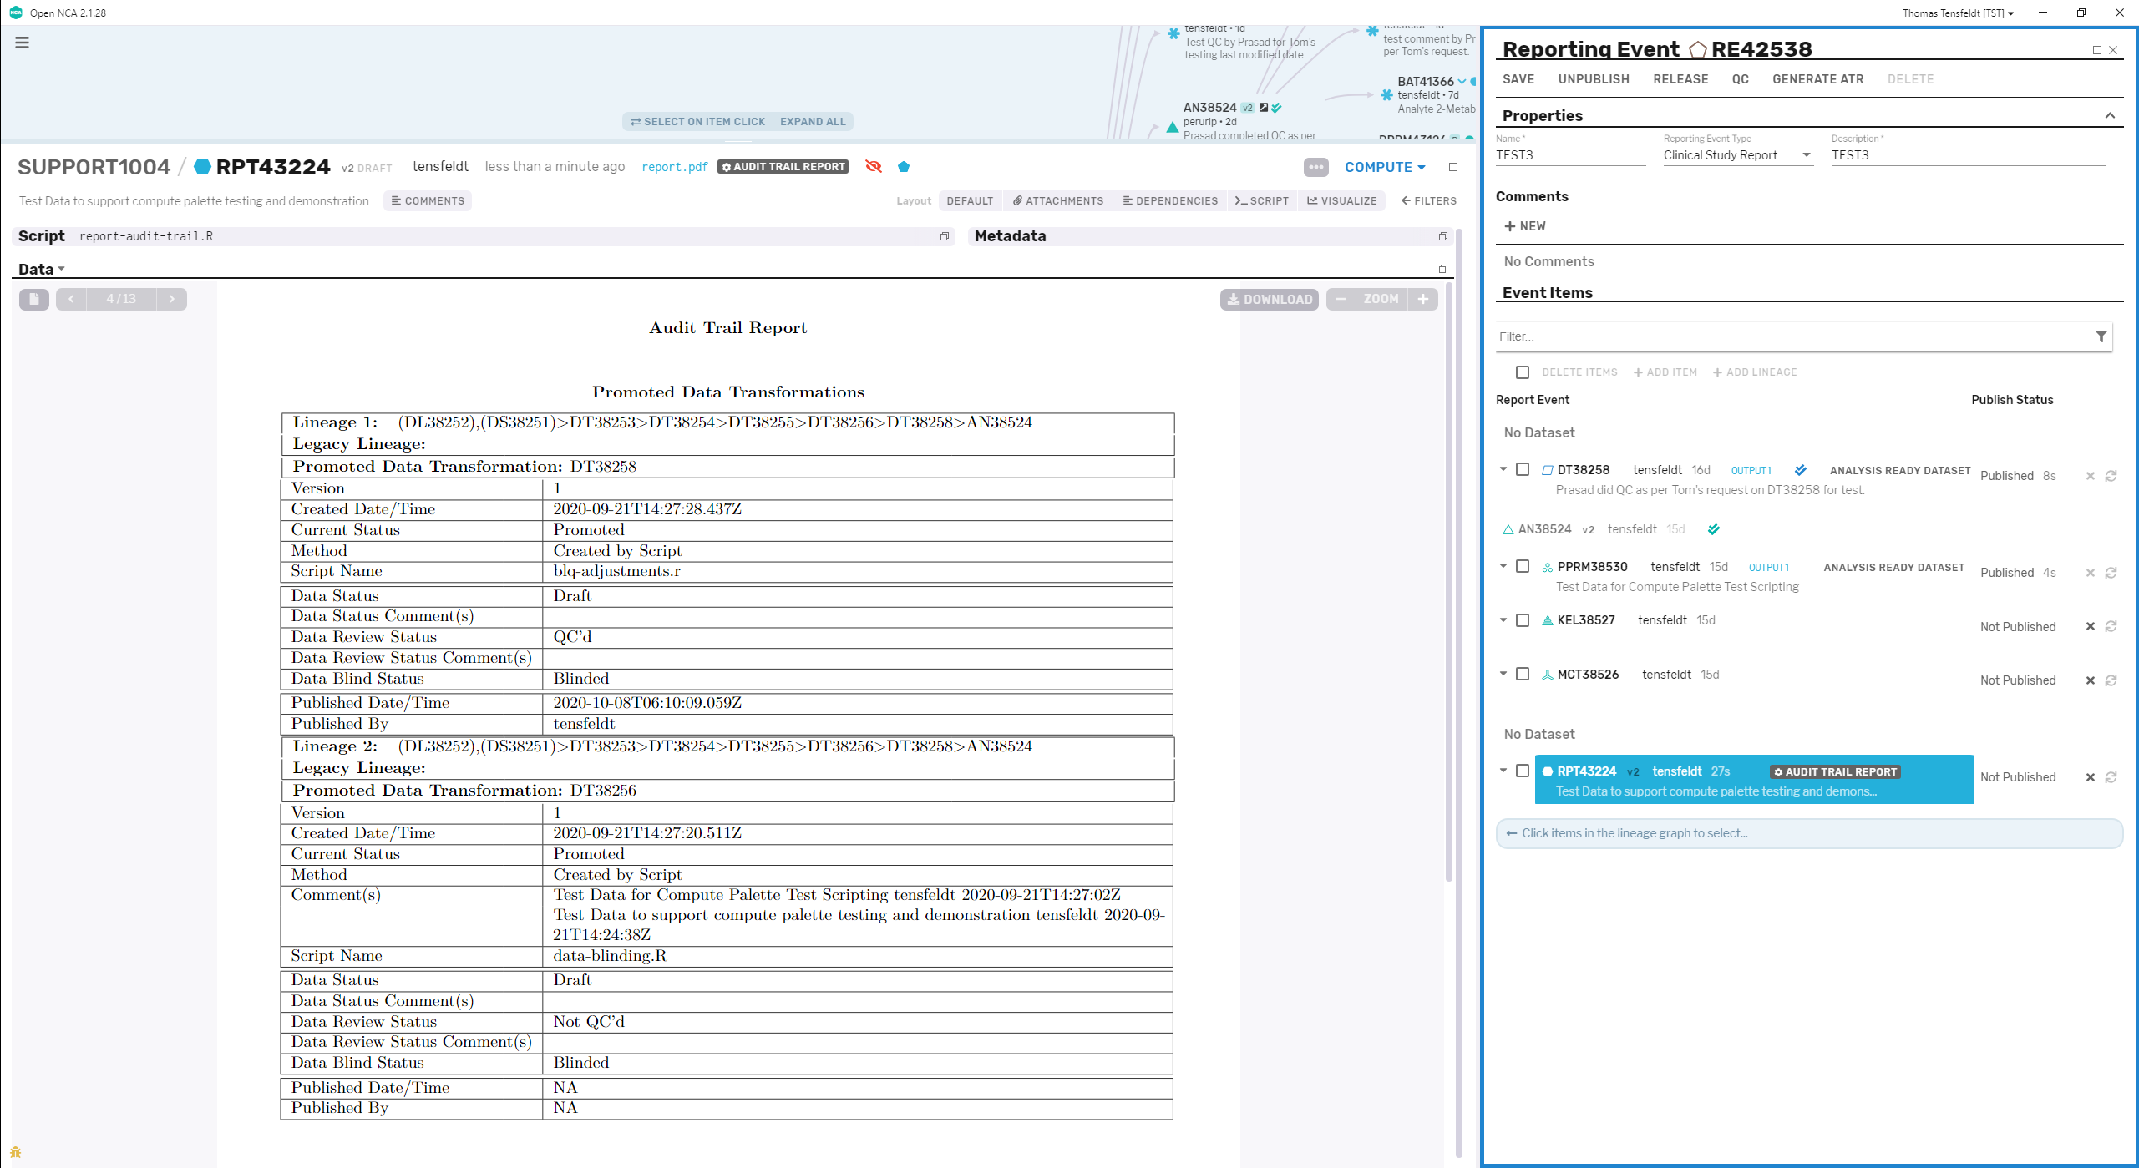
Rmarkdown/LaTeX Report Generation
Web-based Publishing

Slide 17
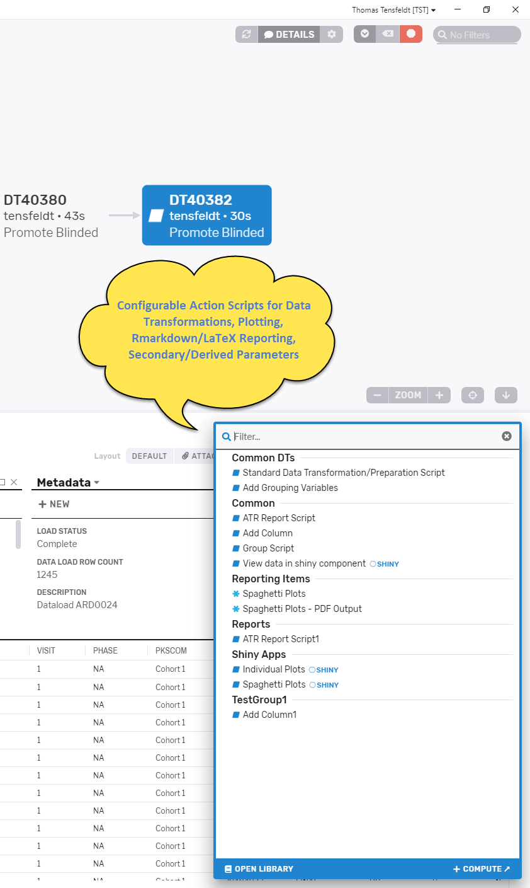
Compute Palettes automate script execution

Slide 18
Non-Compartmental PK Analysis

Slide 19
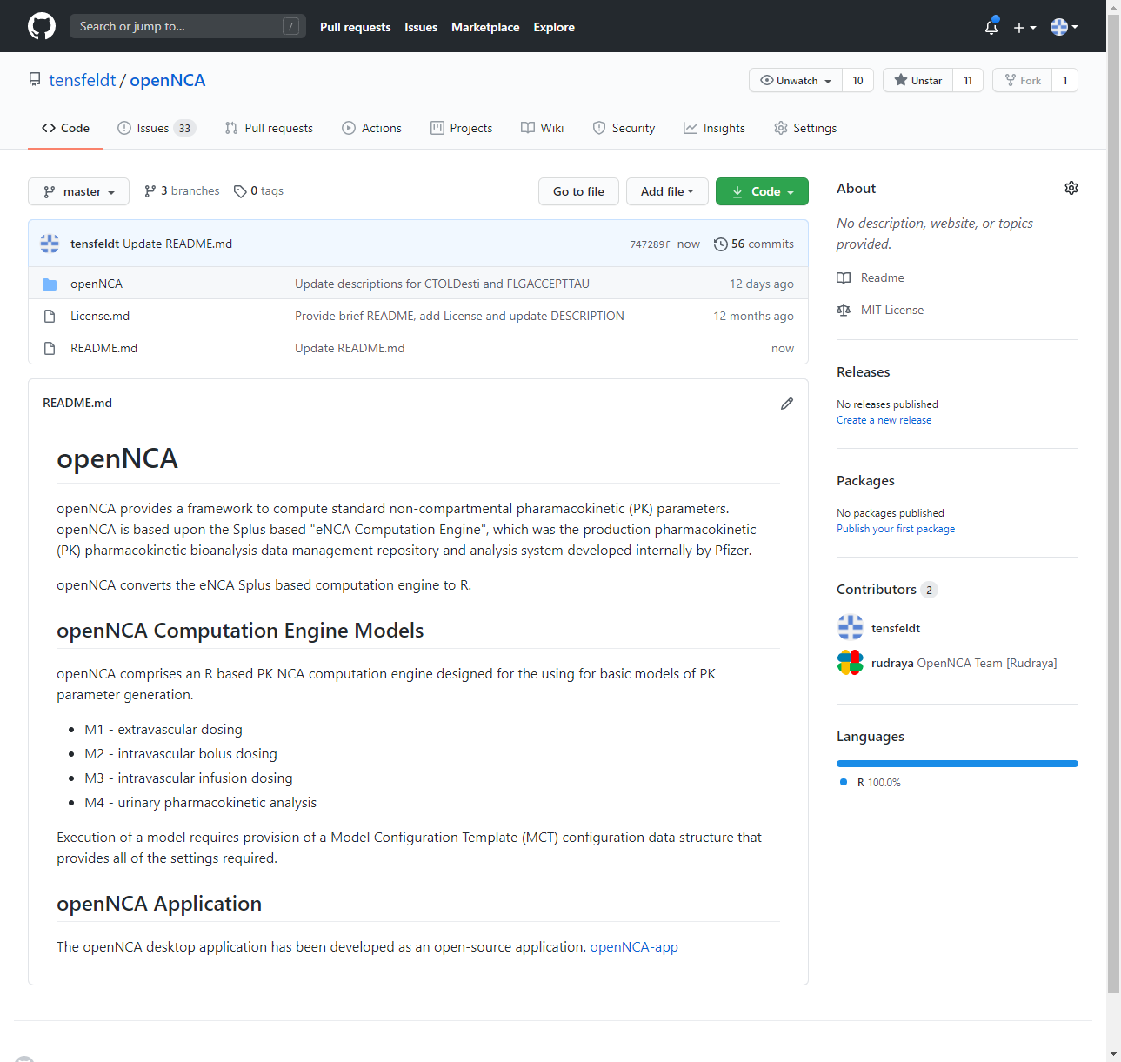
openNCA R Computation Engine
openNCA R Computation Engine (CE)
Approach to NCA defines 4 “Models” defined by a Model Configuration Template:
Model 1 – extravascular dosing
Model 2 - intravenous bolus dosing
Model 3 – intravenous infusion dosing
Model 4 – urinary model (interval sampling)
All models incorporate Single Dose and Steady State (SS) parameter computation, and standard parameters for clinical PK data evaluation including DOSE and Body Size normalized parameters as well as automation for metabolite ratio parameters and the SS allows for multiple dosing intervals within a sampling profile.
Based on Legacy eNCA Splus Computation Engine Code based used in ~1000 clinical studies/100s of regulatory submissions supported
The CE package can be used with pharmacometric workflows (e.g. evaluation of population pk) as a qualified system of NCA computation

Slide 20
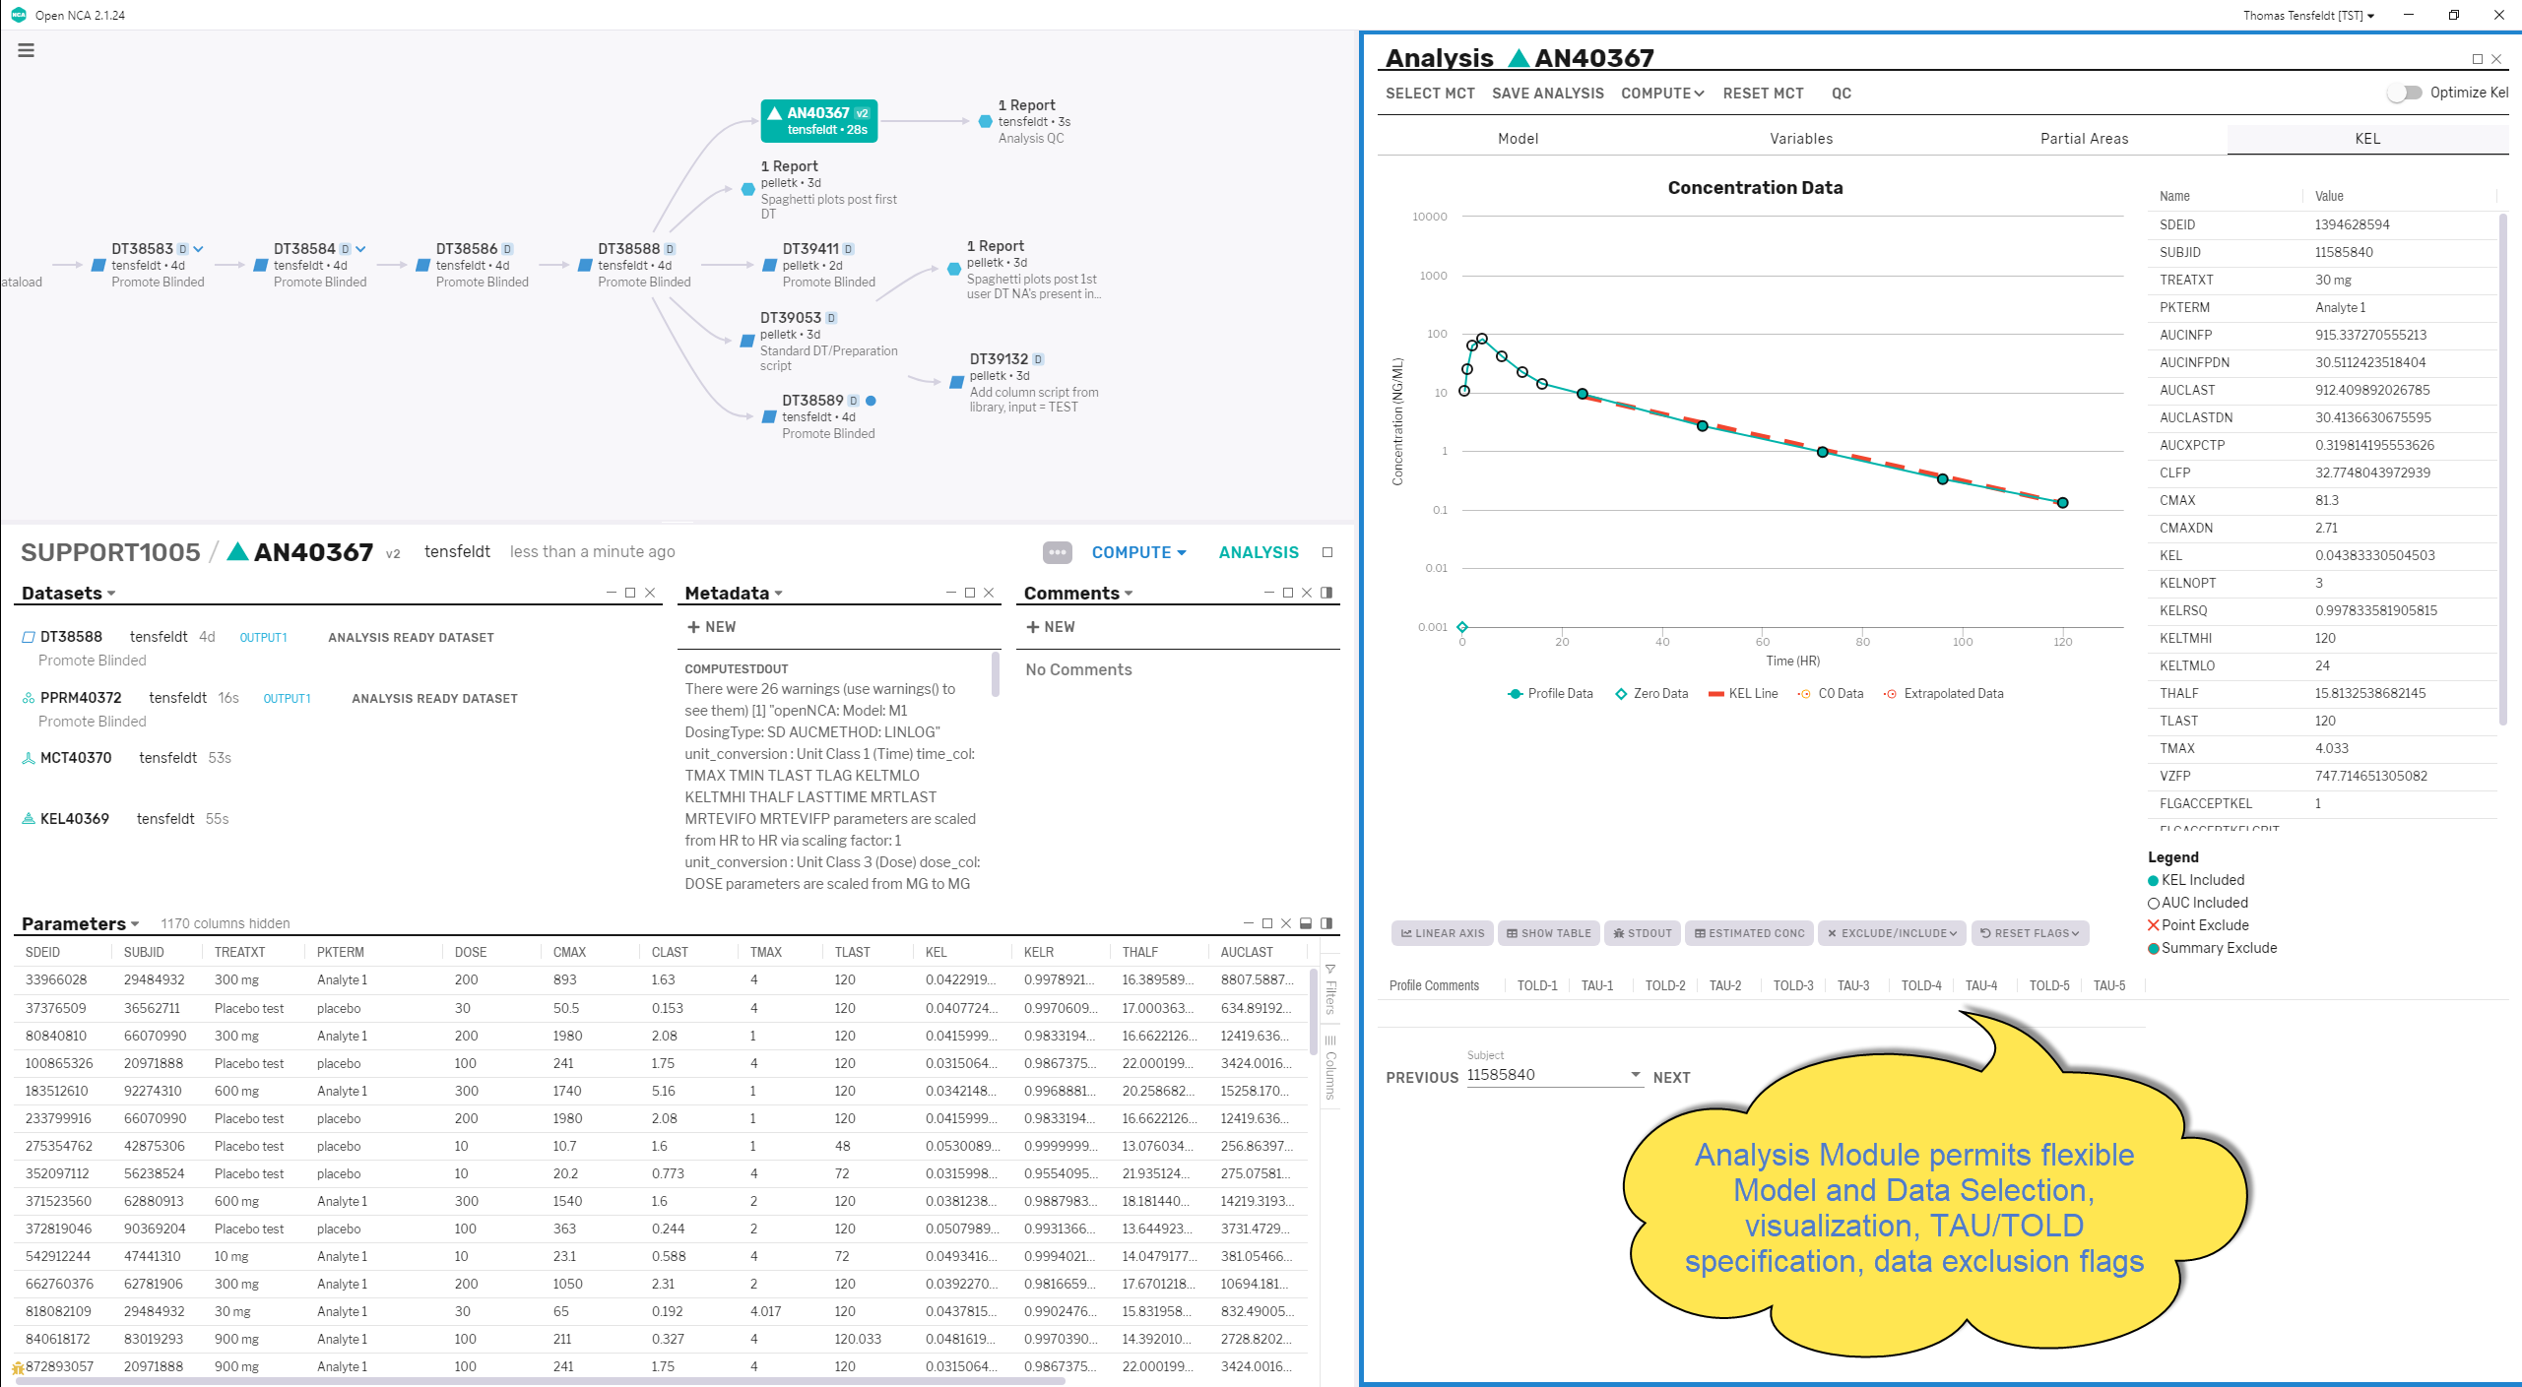
NCA Primary and Derived Parameter Generation

Slide 21
Search

Slide 22
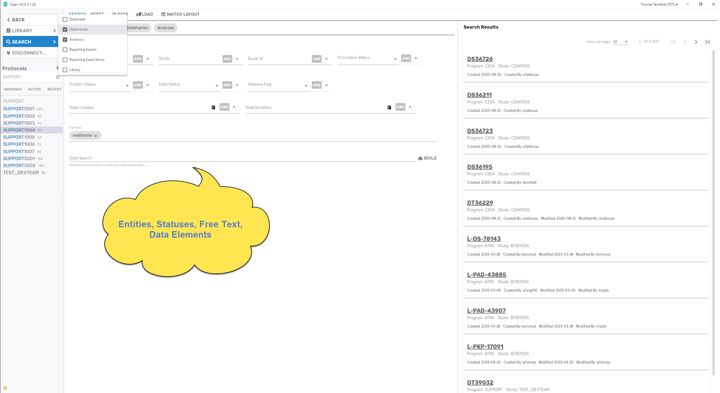
Data, Status, Entity Search

Slide 23
Open Source

Slide 24
Pharmaceutical Open Source Software Consortium (POSSC)
POSSC was formally established in 2018 in collaboration with 11 Pharma companies
Vision for creation of a consortium: promote innovation and collaboration through support to development of open-source software for pharmacokinetic or pharmacometric applications to serve the Clinical Pharmacology and Pharmacometric Community, standardize common elements, strengthen the discipline and ultimately bring new medicines to patients
Feasibility Phase (current status): formation of the consortium, definition of NCA software requirements, and public solicitation for interest and information to deliver the NCA solution
Development Phase: vendor selection, requirements finalization, development initiation
Commence once a decision to proceed has been reached and continue until the first project, NCA software application, is delivered
openNCA – Pfizer offer to bootstrap POSSC NCA project – status in evaluation
Goal: Broaden access, foster collaboration through pharma industry, academia, regulatory agencies, CROs, etc

Slide 25
openNCA
a novel open-source NCA software solution and environment
https://github.com/tensfeldt/opennca
extensible
qualified for regulatory use with full Software Development Lifecycle (SDLC) controls and documentation
an example of a qualified industrial application of the R programming language
a basis for industrial collaboration through open-source software development and innovation for the Clinical Pharmacology and Pharmacometrics disciplines
https://possc.org

Slide 26
Thanks for listening!

